Slide 1

SkyScribe: Drone Technology Website
Welcome to the SkyScribe presentation. We'll explore the features, functionality, and development process of this innovative drone technology website.
Md Sadid Al Deen
221-15-4746
Rafial Mubtasim Showmik
221-15-4817
Abdullah Al Noman
221-15-5856
Tamanna Akter
221-15-5298
Junayed Ahmed Saad
221-15-5715

Slide 2
Introduction
SkyScribe is a drone technology-focused website developed with HTML, CSS, and JavaScript, integrated with Firebase for real-time data
management and user authentication. The platform provides an intuitive interface for drone operations, specifications,
and service management.
Motivation
With the growing adoption of drones across industries, there is a demand for a unified platform to manage drone
operations, track real-time statuses, and provide educational resources.
SkyScribe addresses these needs by integrating state-of-the-art Firebase solutions for seamless user experience.
SkyScribe is a drone technology website built with HTML, CSS, JavaScript, and Firebase.
It provides user management, drone specifications, operational guides, real-time drone status tracking, and service request modules.

Slide 3
Objective
To develop a user-centric, scalable, and real-time drone technology website that:
Enables efficient drone operation management.
Provides access to drone specifications and user guides.
Supports secure user authentication and dynamic data storage.
Facilitates real-time updates on drone status and user activities.

Slide 4
Technology Stack
Frontend
Backend API
Database
HTML, CSS, JavaScript for user interface.
Firebase dependencies: Authentication, database, and hosting.
Firebase Realtime Database with real-time sync capabilities.

Slide 5
Architecture Overview:
1
Frontend:
Built using HTML, CSS, and JavaScript for responsive user interfaces.
2
Backend:
Firebase for authentication, database, and real-time updates.

Slide 6
Detailed Workflows
1
User Workflow
Registration, login, dashboard access, task submission, notifications.
2
Admin Workflow
Admin login, user management, content moderation, system analytics, and real-time monitoring.

Slide 7
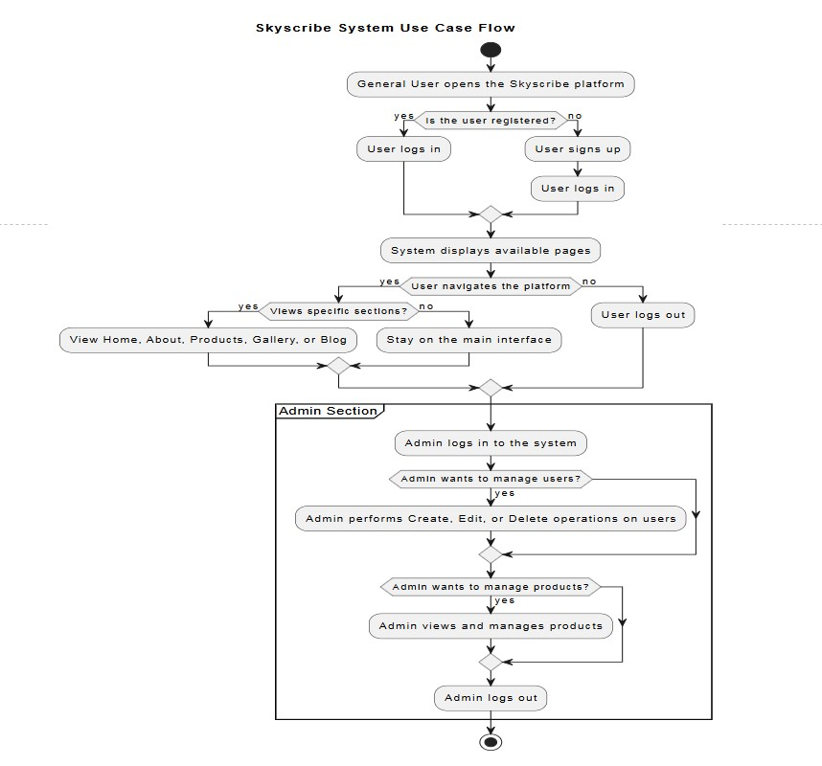
Activity Diagram:
SkyScribe is a drone technology website built with HTML, CSS, JavaScript, and Firebase.
It provides user management, drone specifications, operational guides, real-time drone status tracking, and service request modules.

Slide 8
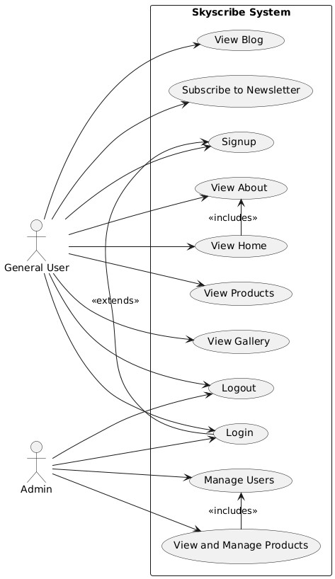
Use Case Diagram:
SkyScribe is a drone technology website built with HTML, CSS, JavaScript, and Firebase.
It provides user management, drone specifications, operational guides, real-time drone status tracking, and service request modules.

Slide 9
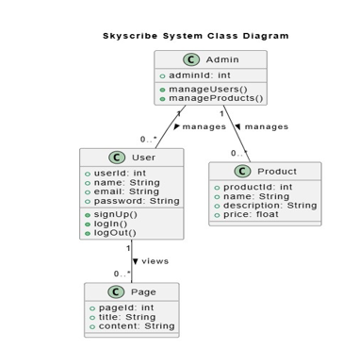
Class Diagram:
SkyScribe is a drone technology website built with HTML, CSS, JavaScript, and Firebase.
It provides user management, drone specifications, operational guides, real-time drone status tracking, and service request modules.

Slide 10
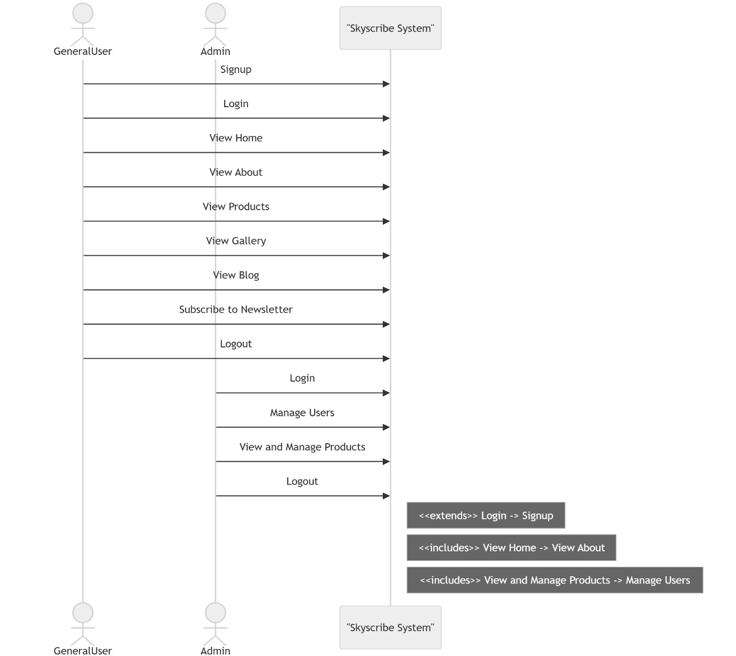
Sequence Diagram:
SkyScribe is a drone technology website built with HTML, CSS, JavaScript, and Firebase.
It provides user management, drone specifications, operational guides, real-time drone status tracking, and service request modules.

Slide 11
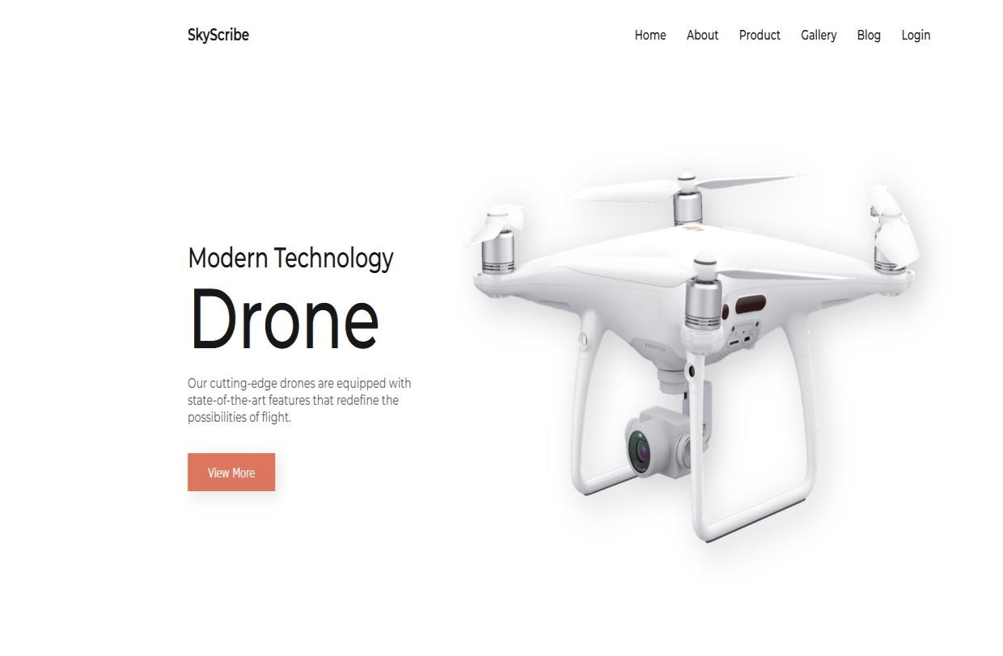
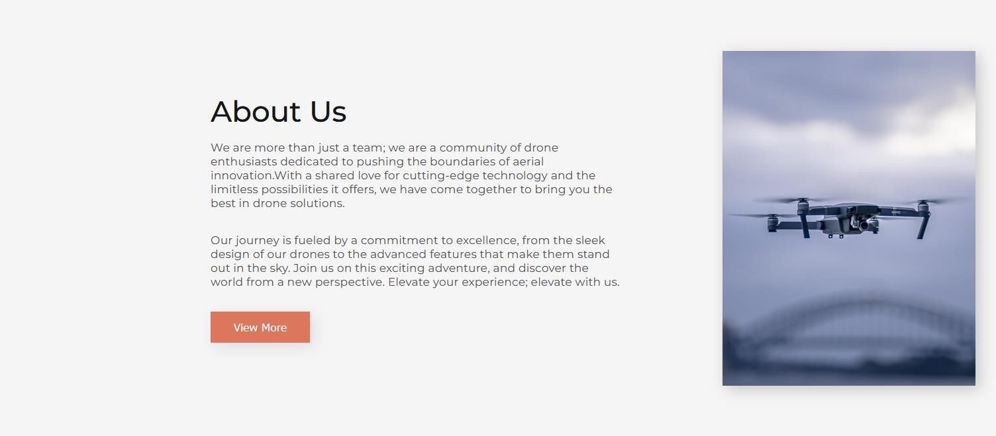
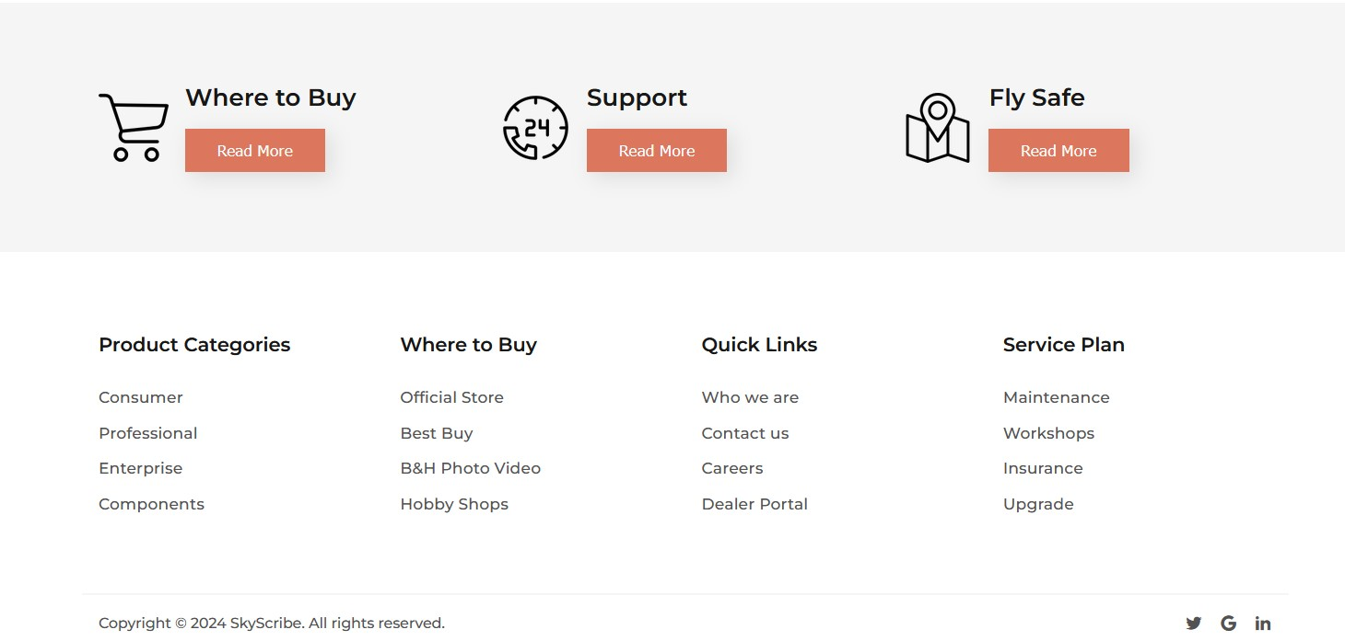
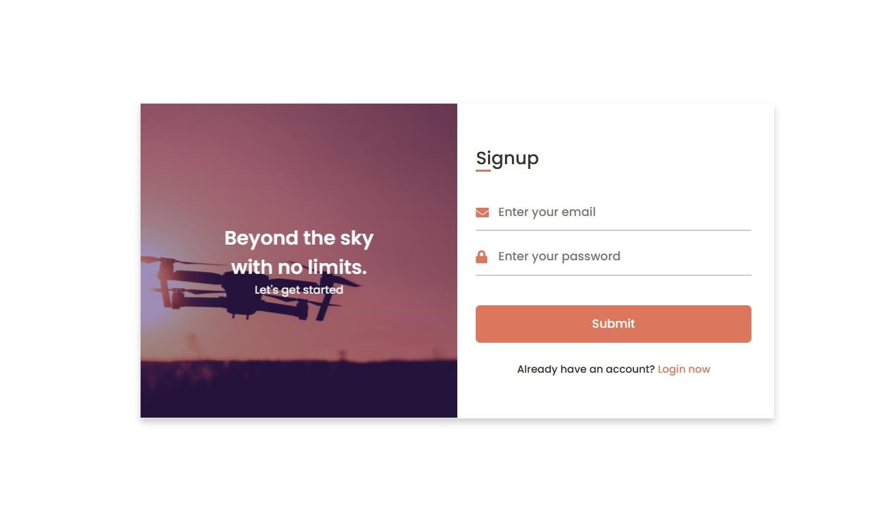
GUI:
SkyScribe is a drone technology website built with HTML, CSS, JavaScript, and Firebase.
It provides user management, drone specifications, operational guides, real-time drone status tracking, and service request modules.

Slide 12
Key Features of SkyScribe:
🔒 User Authentication (via Firebase)
🚁 Drone Management (specs, operations, maintenance logs)
📊 Real-Time Drone Tracking
📝 Service Request Module
📚 Operational Guides
📧 Push Notifications & Alerts

Slide 13
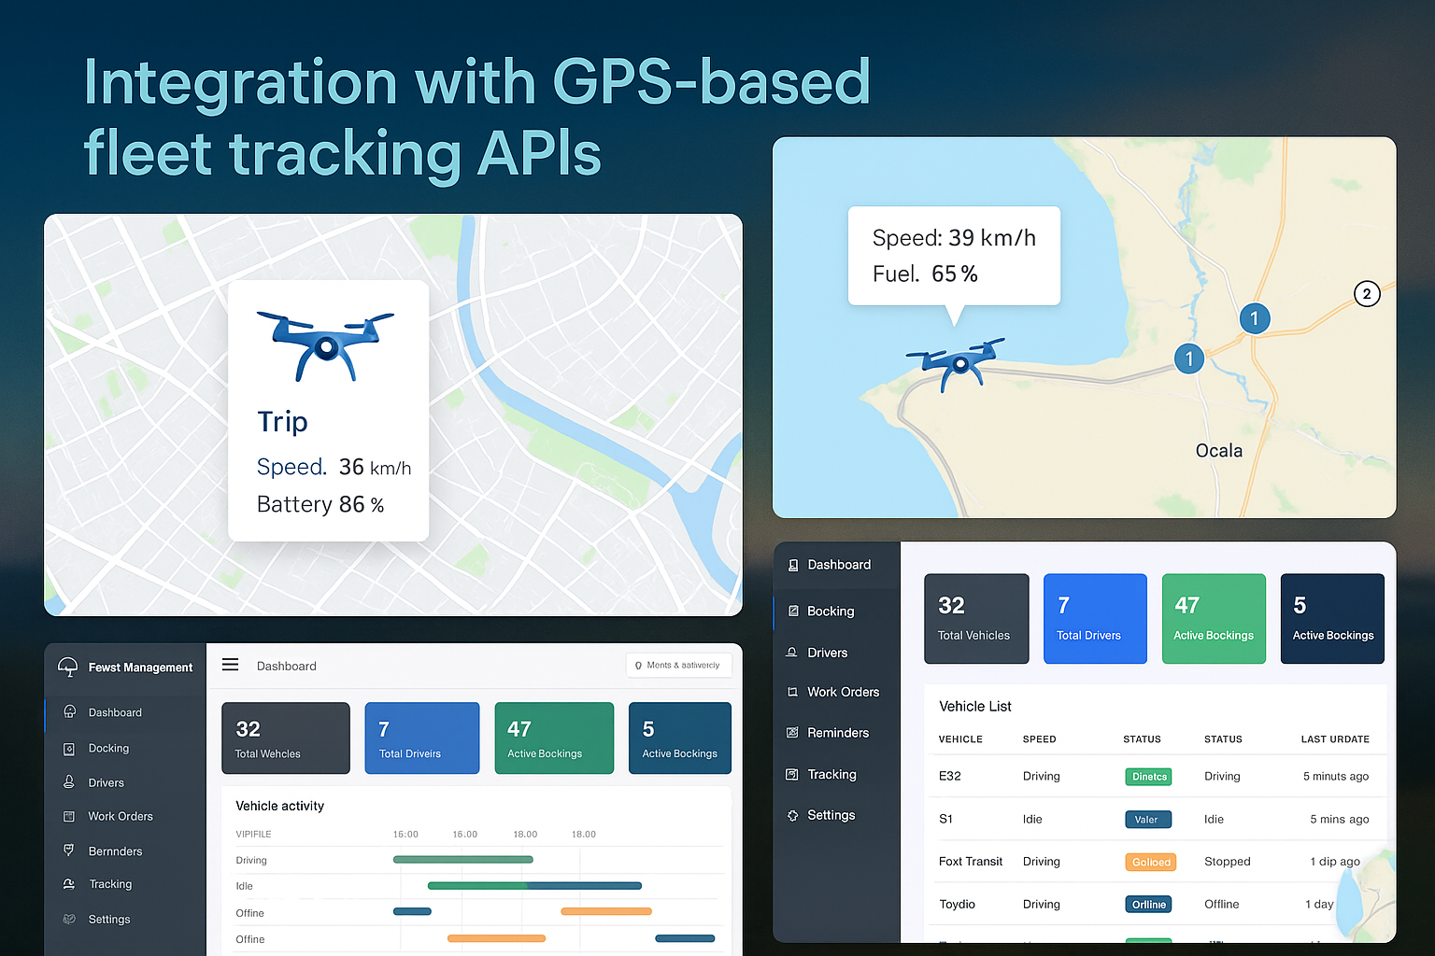
Future Scope & Enhancements:
Integration with GPS-based fleet tracking APIs
AI-based drone behavior prediction & fault alerts
Progressive Web App (PWA) version
Role-based access control (Admin/User/Technician)
Support for video streaming during drone flight

Slide 14





Testing Process
User Acceptance Testing
1
Gather feedback from users to ensure features meet requirements.
End-to-End Testing
2
Simulate user workflows to validate application behavior.
Integration Testing
3
Ensure seamless interaction between frontend and backend APIs.
Unit Testing
4
Verify individual modules like authentication and task handling.

Slide 15
Conclusion
SkyScribe delivers a seamless platform for drone management using modern web technologies and Firebase.
It ensures secure, scalable, and real-time user interaction and data management.
Sets a strong foundation for future enhancements in drone technology solutions.

Slide 16
THANK YOU

